Slide 1
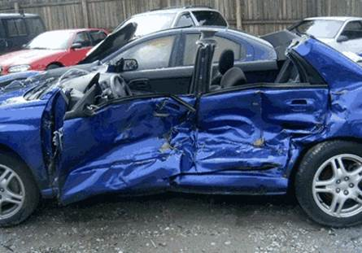
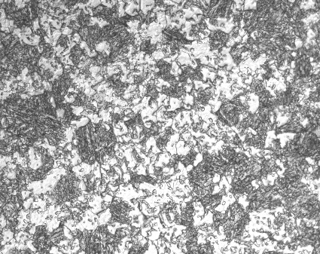
Opportunities for Inverse Analysis in Dynamic Tensile Plasticity Measurements
S.P. Mates¹, F. Abu-Farha²
¹NIST, 100 Bureau Drive Stop 8553, Gaithersburg, Maryland 20893
²Clemson University – International Center for Automotive Research, Greenville, SC 29607
Notes:
Changed the title to plasticity – from strength.

Slide 2
Outline
Motivation
Study of next-generation structural sheet materials for use in the automotive industry
Tensile Kolsky Bar Measurements
For understanding dynamic behavior of these new materials (strength, ductility)
Opportunities for Inverse Methods to enhance data value in traditional dynamic testing?

Slide 3
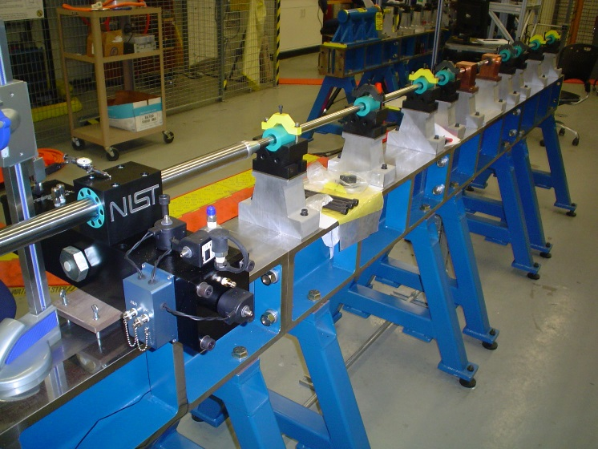
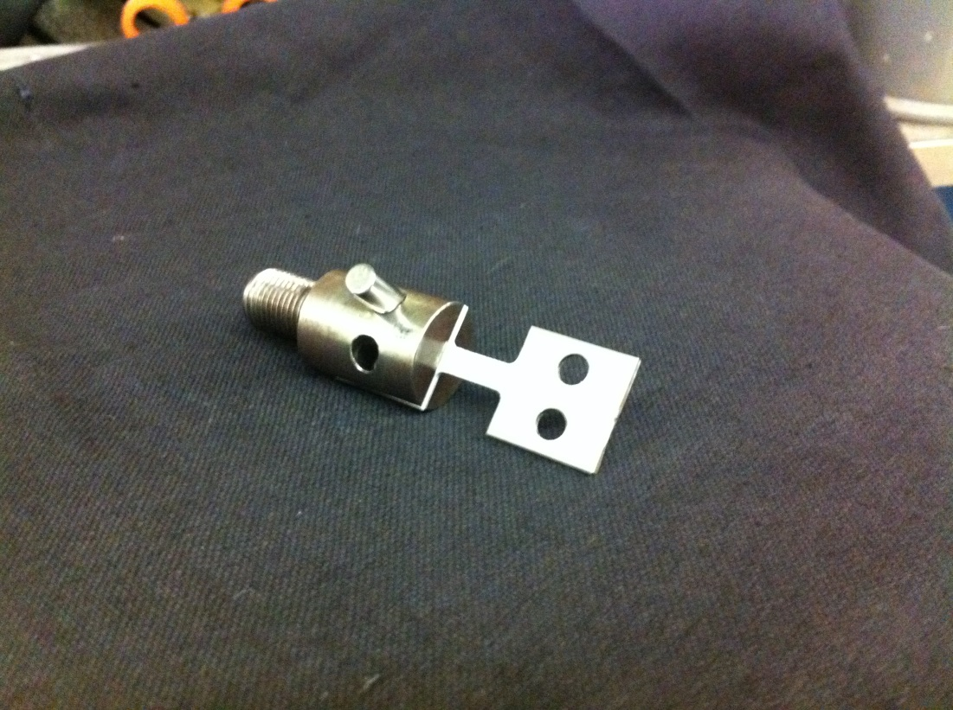
NIST Tension Kolsky Bar
Threaded
Coupler
Tension
Sample
Launch Barrel
(Steel, 26 mm OD, mm ID)
Incident Bar
(Steel, 26 mm OD)
Impedance Matched
to Launch Barrel
Transmission Bar
(Aluminum, 20 mm)
Tension Sample and Grip
(Grip is 20 mm in dia)
Notes:
Direct tension method to facilitate DIC measurements on the specimen – very important

Slide 4
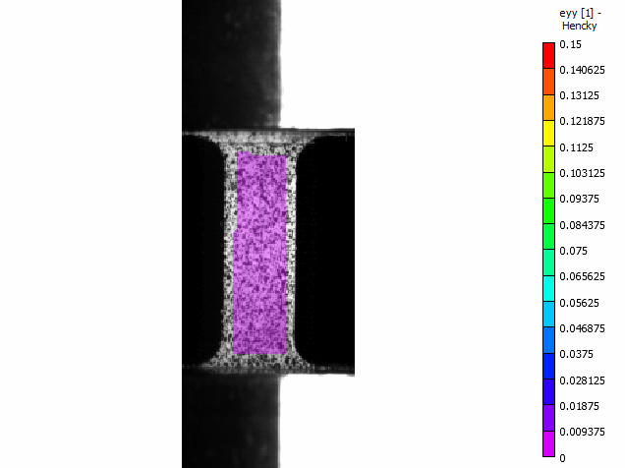
Traditional Tension Kolsky Bar Test Results
Transmission
Bar
True Axial Strain
Usual Requirements/Assumptions
1) Force Equilibrium
2) Constant Strain Rate
3) Uniform Strain in the Gage Section
10 mm
Incident
Bar
3D DIC
90k fps
Notes:
This is test 735, press hardened steel, with fracture

Slide 5
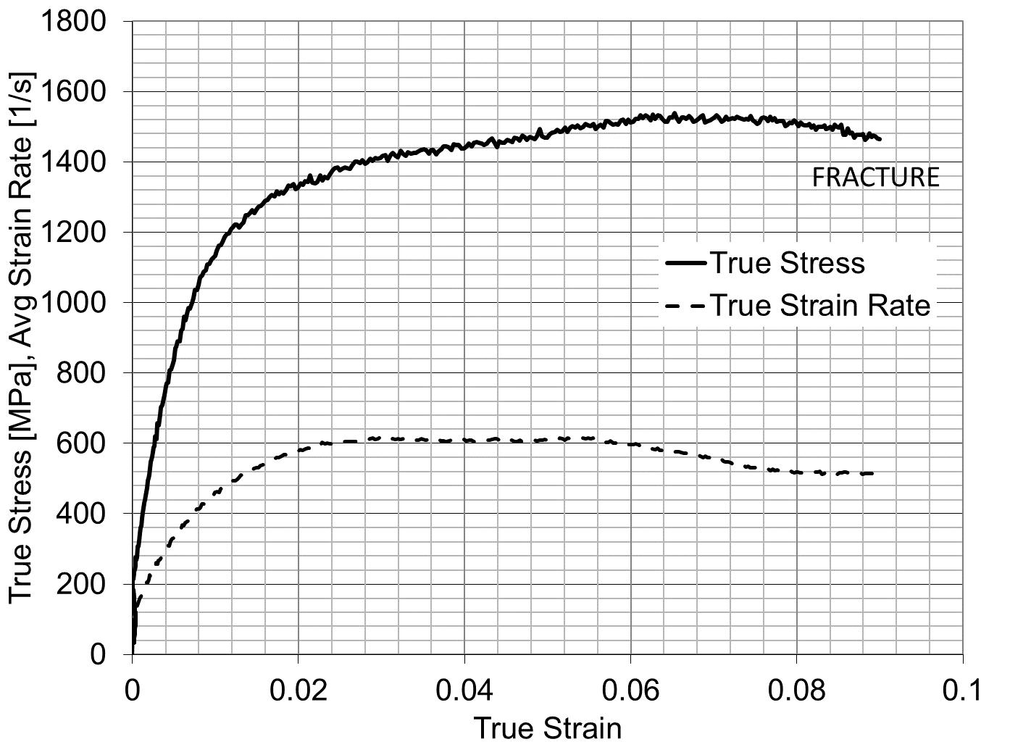
Typical Tension Kolsky Bar Test Results
Transmission
Bar
True Axial Strain
Stress-Strain and Strain Rate Data
Ringup
Equilibrium
Necking & Fracture
10 mm
Incident
Bar
Ringup: Specimen is accelerating, not in force equilibrium, and strain rate is rapidly increasing
3D DIC
90k fps
Equilibrium: Strain rate is stabilized, specimen is in force equilibrium, no acceleration
Necking and Fracture: Strain localizes and specimen eventually fractures
Notes:
This is test 735, press hardened steel, with fracture

Slide 6
Opportunities for Inverse Analysis
Ringup
From zero load to equilibrium deformation
Strain rate changing, force equilibrium not established (specimen is accelerating)
Opportunity for Inverse Analysis (OIA): data are questionable and often ignored
Equilibrium Deformation
Strain rate is stabilized, force equilibrium achieved
OIA: strain distribution non-uniformity (sample geometry, material behavior)
Necking/localization and fracture
Onset of necking to fracture
Non-uniform strain and strain rate, local area reduction
OIA: data must be discarded
Notes:
Traditional test we usually only consider part 2 – equilibrium portion. So there is opportunity to ENHANCE the value of the data outside these areas.

Slide 7
FEA vs. Non-FEA: Inverse Methods
Finite Element Analysis (FEA) Based
Non FEA – Virtual Fields Method (VFM)
Involves solving FEA approximation of test and iterating constitutive parameters to find a global minimum error between experiments (DIC and load data) and FEA result.
Involves solving an explicit or implicit set of algebraic equations using DIC data to directly identify constitutive parameters.
Notes:
Note again the P = 0.75 corresponds well with the ISO recommendation of using the shoulders as part of the effective gauge length of the specimen as part of a correction of sorts.
But is the correction for the peaked strain profile, or is it due to yielding outside the gage section???

Slide 8
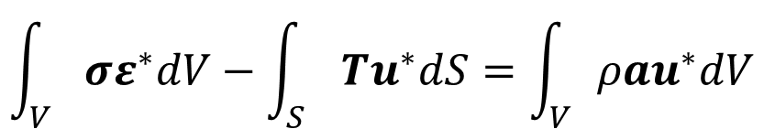
Ringup: Considerations
FEA Method
Dynamic Virtual Fields Method (dVFM)
Iteratively solve FEA model of test with appropriate boundary conditions
Must define objective functions to minimize difference between FEA Results and DIC & Load-Time Measurements
Makes use of acceleration field (a) obtained from second derivative of displacement field to determine inertial forces
$$\int_{V}{σε^{∗}dV−\int_{S}{Tu^{∗}dS=\int_{V}{ρau^{∗}dV}}}$$
Bold – vector/tensor
* - virtual quantity
derived from DIC strain field and constitutive parameters
T derived from external load-time data (if needed)
a derived from second derivative of DIC displacement data

Slide 9
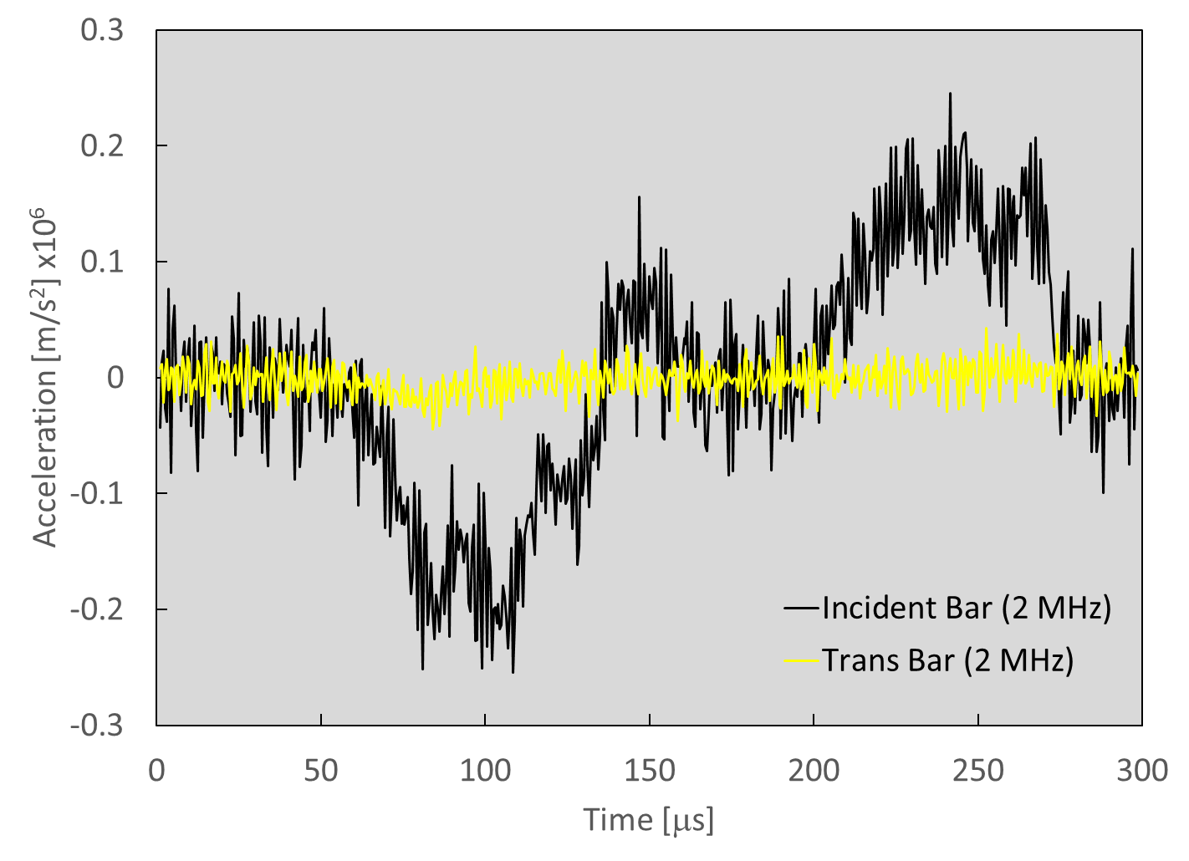
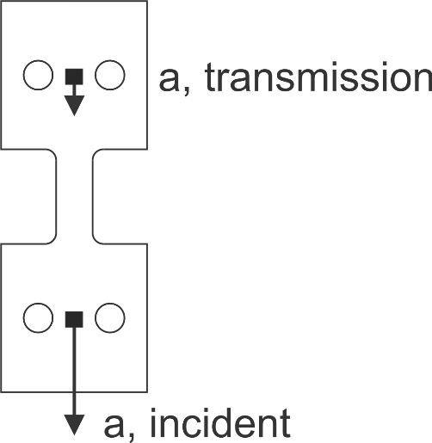
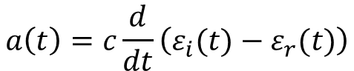
Ringup: Accelerations from Strain Gage Data
2 MHz recording rate (faster than most current cameras)
$$a\left(t\right)=c\frac{d}{dt}\left(ε_{i}(t)−ε_{r}(t)\right)$$
Tension Sample (2D - Sheet)
Ringup
Equilib-
rium
Order h2
1 cm
a - acceleration
Notes:
Question is – how well can we resolve these accelerations with our DIC cameras?
Note also we ignore the last portion where the bar is decelerating – might also make use of this data as well.

Slide 10
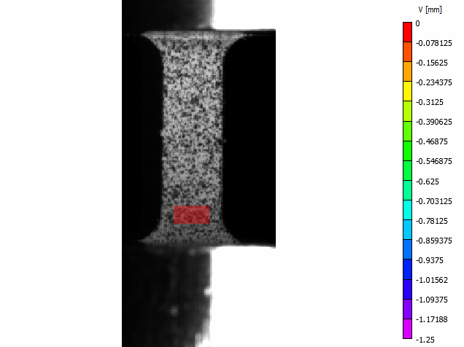
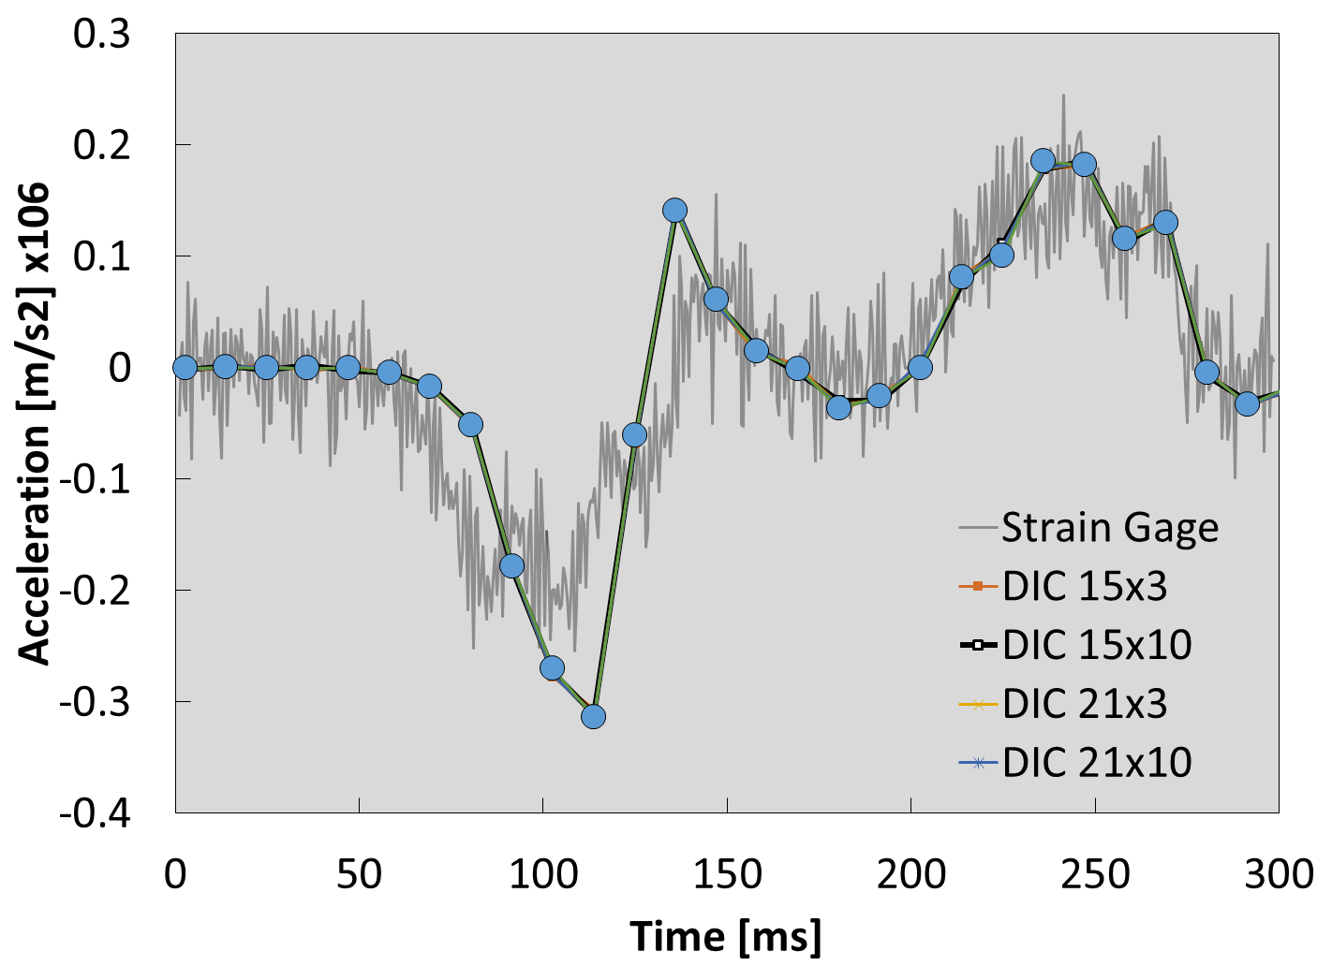
Ringup: 3D DIC on Sample (90k frames/s)
Displacement [mm]
DIC accelerations from second derivative of displacement data (order h²)
Correlated
Region
DIC Accelerations at 90 kfps deviate from strain gage data
Subset/step size variations have little effect
Notes:
Missing some of the features that are present in the strain gage data – which considering the frame rate at only 90 kfps is not surprising.

Slide 11
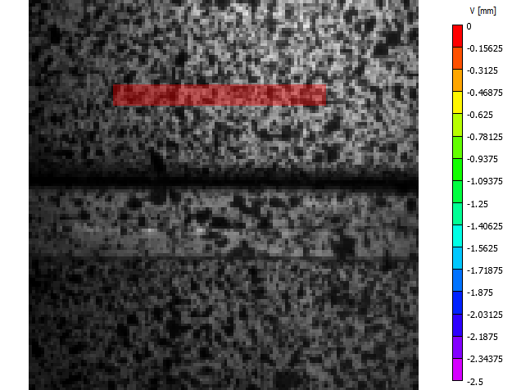
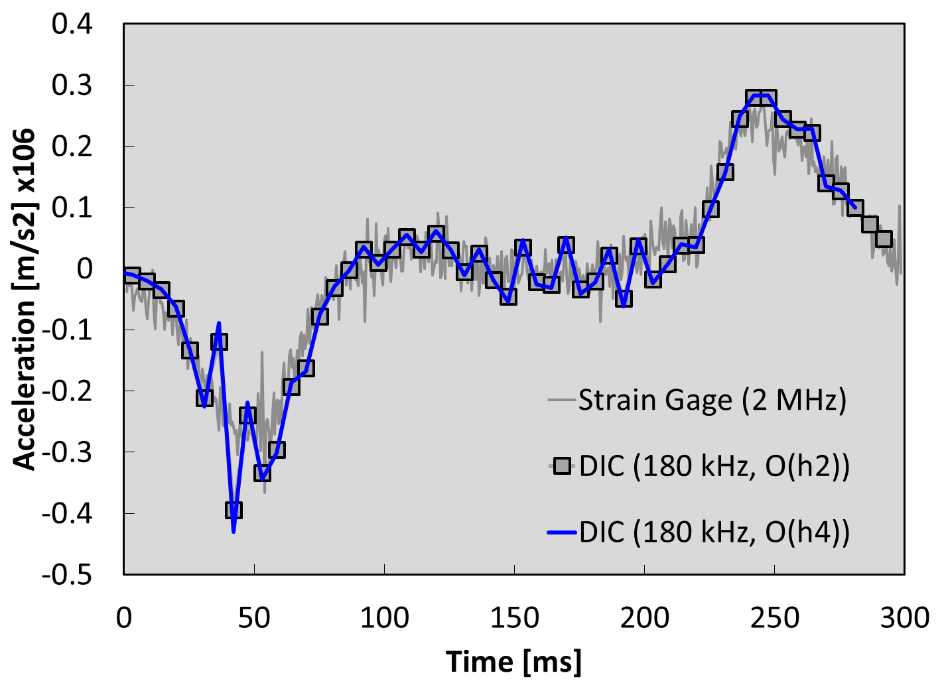

Ringup: 3D DIC on Grip (No Sample, 180 kfps)
Displacement [mm]
DIC 25x7
Grip
Washer
I Bar
Grip
Higher DIC data rate (180 kHz) better matches acceleration from strain gages
Data shows that grip slip/vibrations can add unwanted features to the data – practical aspect
Notes:
In this test we have a longer steady state period – used a longer striker bar here (500 mm vs 375 mm in previous tests).
Practical aspect of doing dynamic tests with or without inverse methods is that you need very high stiffness of the gripping mechanism to avoid unwanted features in your acceleration

Slide 12
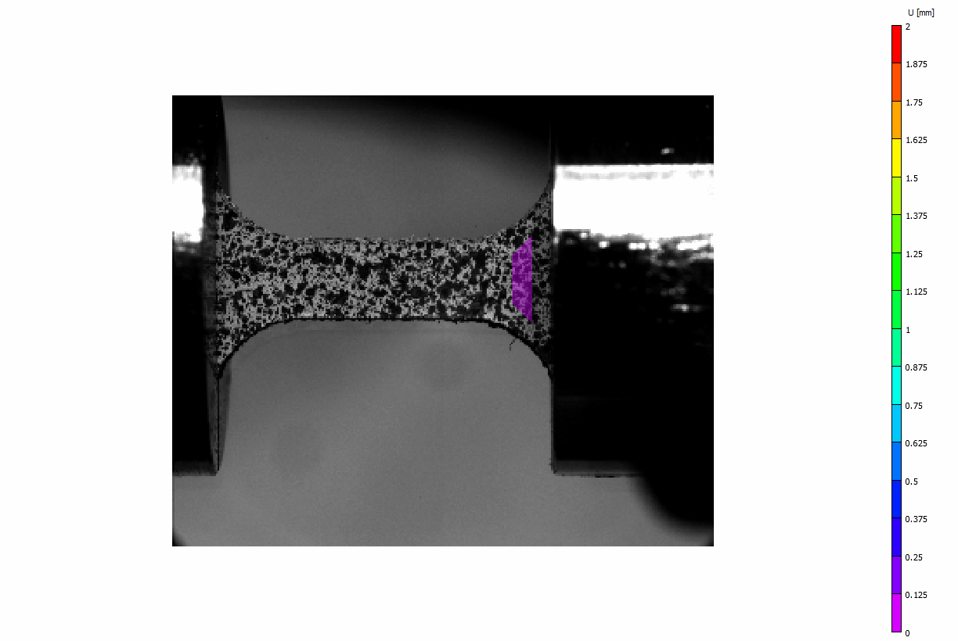
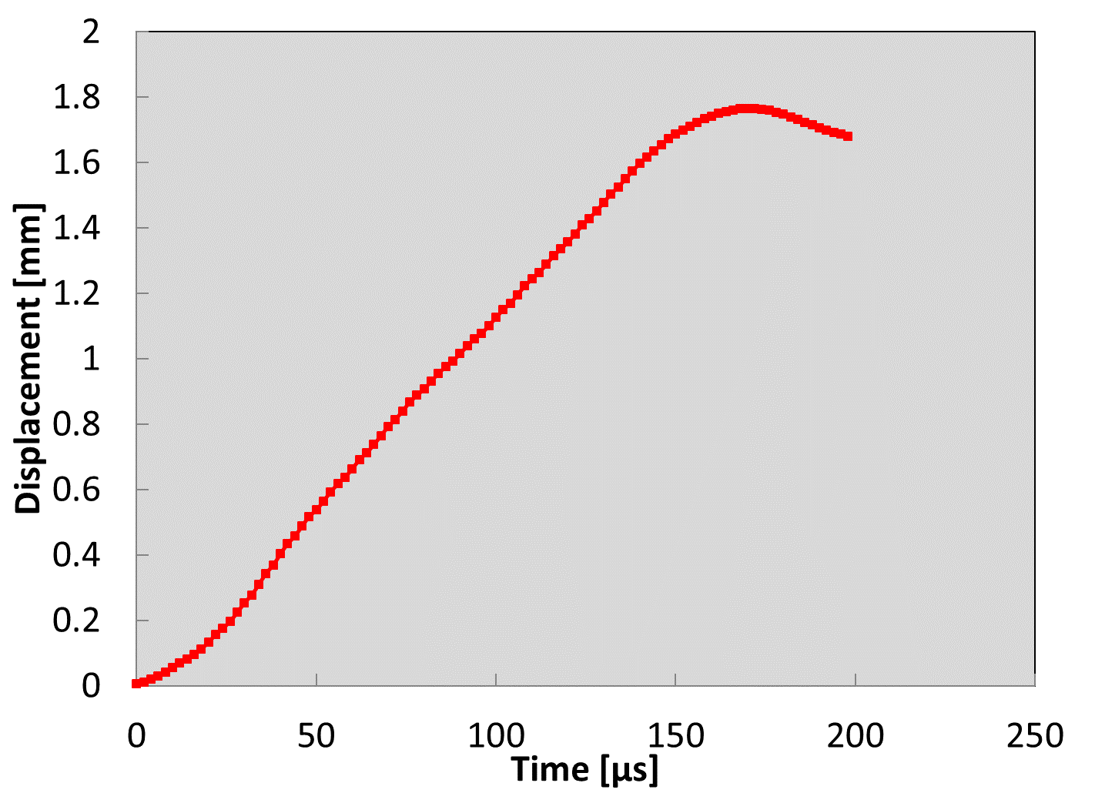
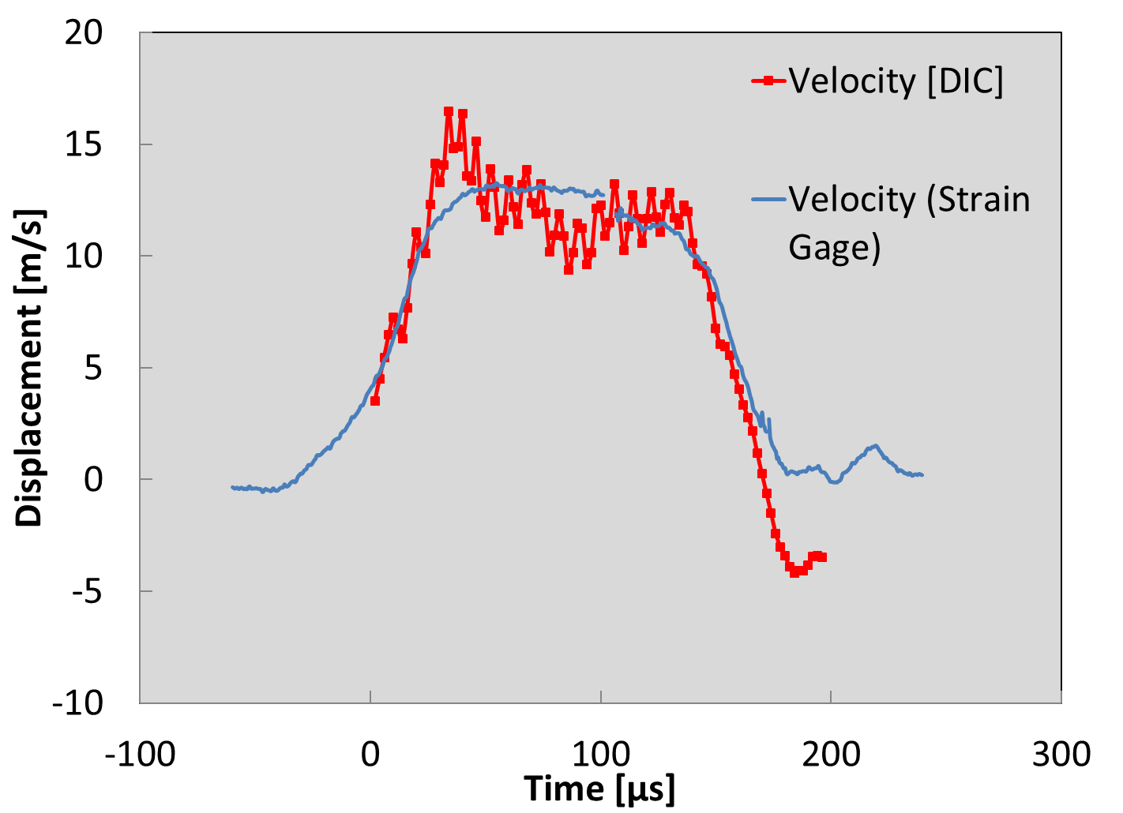
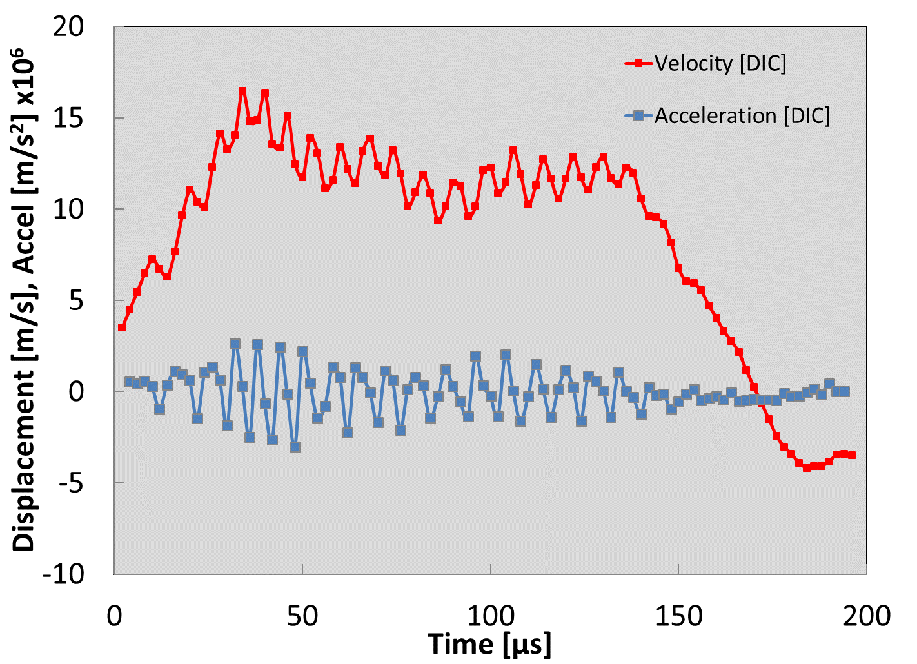
Ringup: 2D DIC, Very High Speed (500 kfps)
Displacement [mm]
Correlated
Region
Displacement (Incident Side)
Velocity (Incident Side)
Copper Sheet Specimen
2D DIC – 17x3
Noise in displacement field confounds acceleration measurement

Slide 13
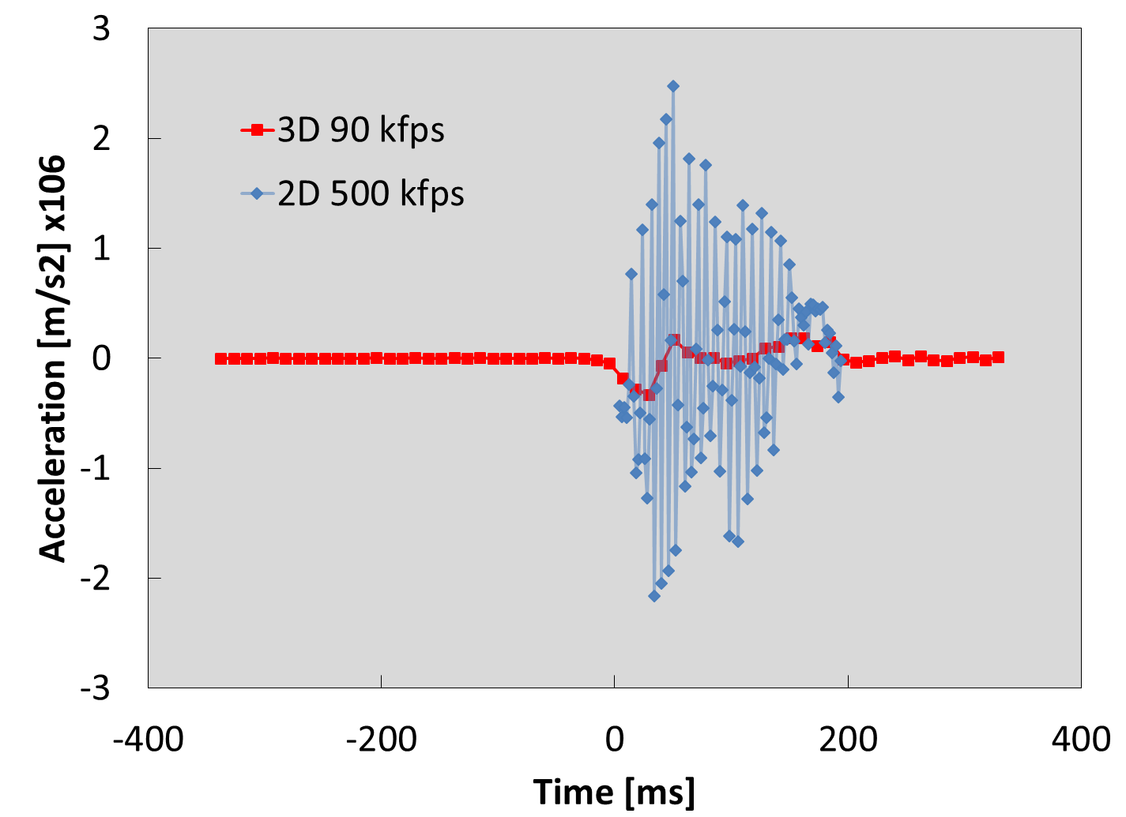
Acceleration Noise Increases with Frame Rate
Much higher levels of noise in 2D, 500 kfps DIC data for similar experimental conditions.
Why?
Notes:
Can reduce this by averaging but it’s difficult.
These are two quite similar experiments.

Slide 14
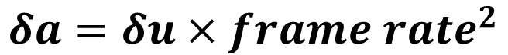
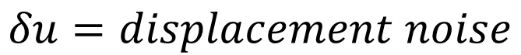
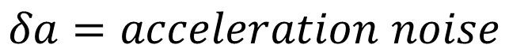
Effect of Frame Rate on Acceleration Noise
The acceleration noise scales with the square of the frame rate
Need to rapidly reduce displacement noise as frame rate increases:
Need higher resolution, larger subsets, better contrast as camera speed goes up.
$$δu=displacement noise$$
$$δa=acceleration noise$$
$$δa=δu×{frame rate}^{2}$$

Slide 15
Summary: Ringup
Success with dVFM requires
Very high speed cameras (180k fps +)
Very low displacement noise
Frame rate can be counter productive here
dVFM might be better leveraged with experiments specifically designed to provide a smoothly varying accelerations
FEA methods should be applicable
Experimental challenge: you need very stiff specimen grips

Slide 16

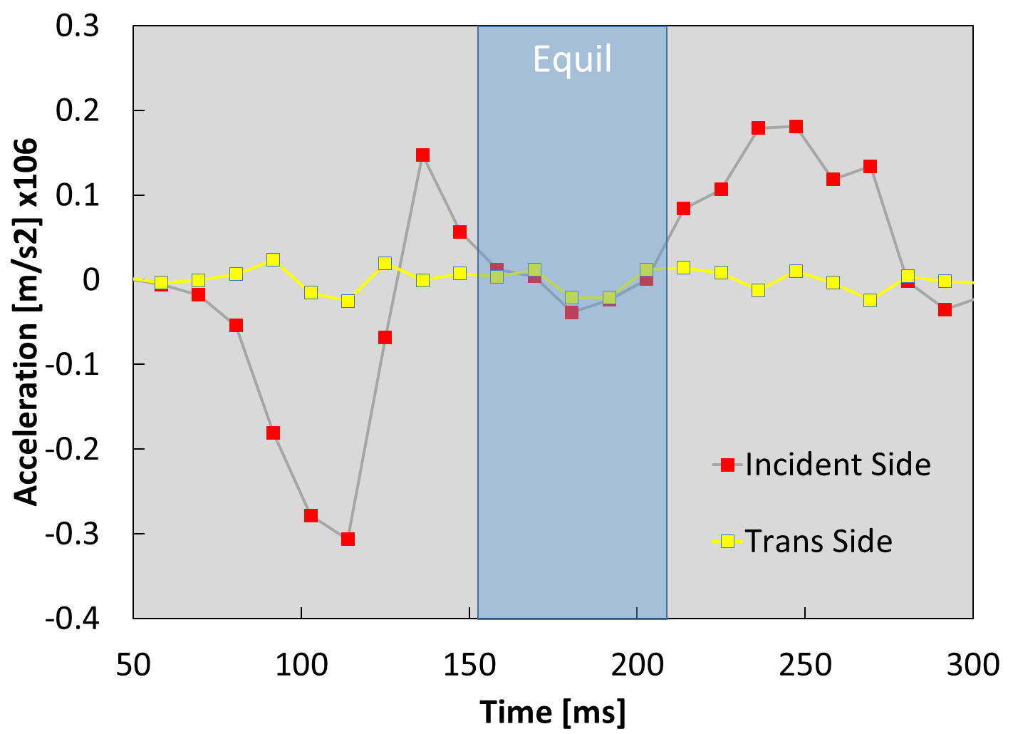
Equilibrium Deformation
Equilibrium deformation: zero net force (therefore zero acceleration)
Equilibrium occurs after ringup period ends
Ideally, the strain should be uniform in the gage section during this portion of the test…
Accelerations from 3D DIC, 90 kfps
Notes:
Note again the P = 0.75 corresponds well with the ISO recommendation of using the shoulders as part of the effective gauge length of the specimen as part of a correction of sorts.
But is the correction for the peaked strain profile, or is it due to yielding outside the gage section???

Slide 17
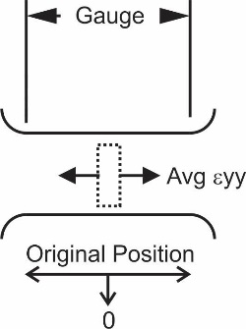
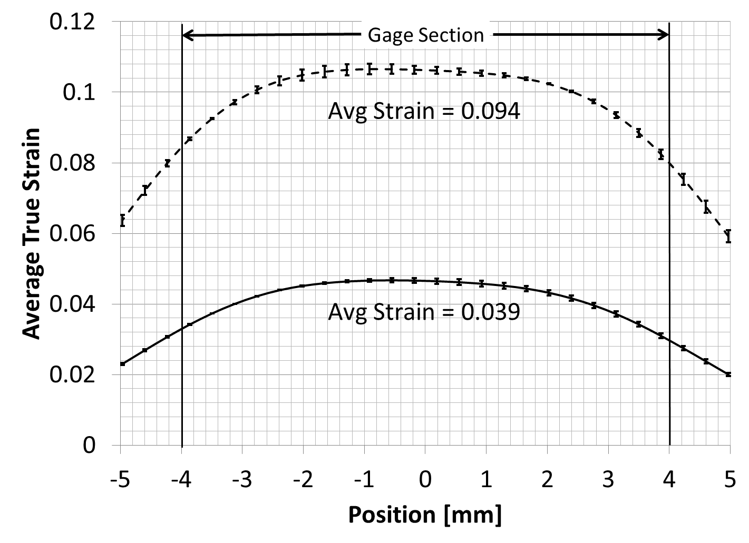
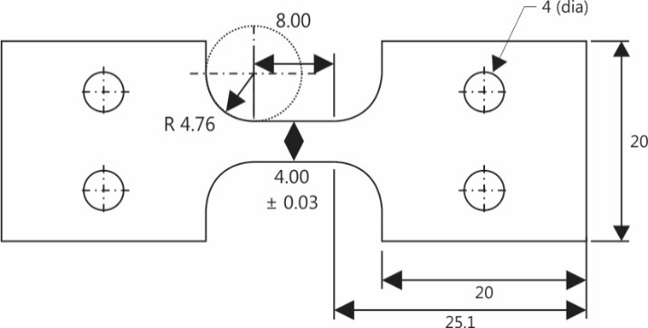
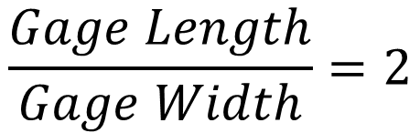
Strain Uniformity: Copper
Good uniformity over much of the gage section
Copper Specimen Dimensions [mm]
$$\frac{Gage Length}{Gage Width}=2$$
3D DIC, 75 kfps

Slide 18
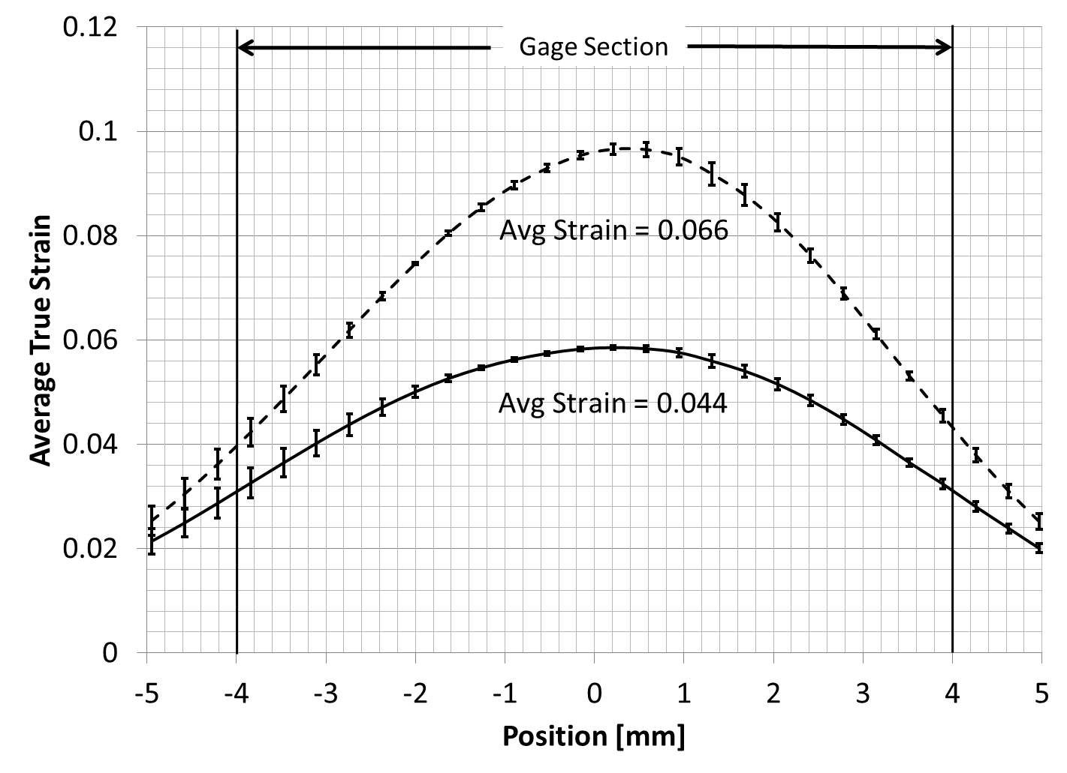
Strain Uniformity: Titanium (Ti-6Al-4V)
Terrible uniformity due to lack of strain hardening
Ti-6-4 Specimen Dimensions [mm]
Same specimen as Copper test!
3D DIC, 75 kfps

Slide 19
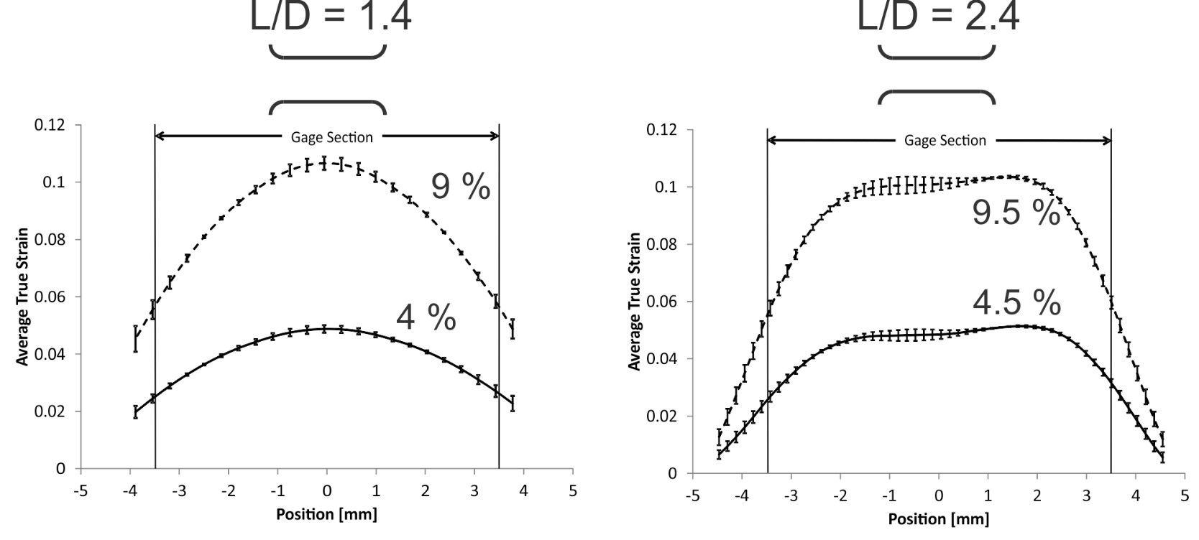
Strain Uniformity: Specimen Design
By increasing L/D we can improve strain uniformity…
High Strength Steel
… but, when we change geometry we also change the strain rate, so it’s not a perfect solution.

Slide 20
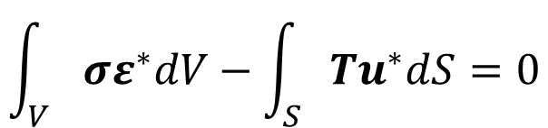
Equilibrium Deformation: Considerations
FEA Method
Virtual Fields Method (VFM)
Same as ringup
Can apply regular VFM for non-linear constitutive equations, large deformations:
Must also include effect of adiabatic heating
$$\int_{V}{σε^{∗}dV−\int_{S}{Tu^{∗}dS=0}}$$
Bold – vector/tensor
* - virtual quantity
derived from DIC strain field and constitutive parameters
T derived from external load-time data (if needed)
Notes:
Note again the P = 0.75 corresponds well with the ISO recommendation of using the shoulders as part of the effective gauge length of the specimen as part of a correction of sorts.
But is the correction for the peaked strain profile, or is it due to yielding outside the gage section???

Slide 21
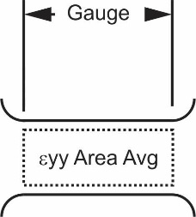
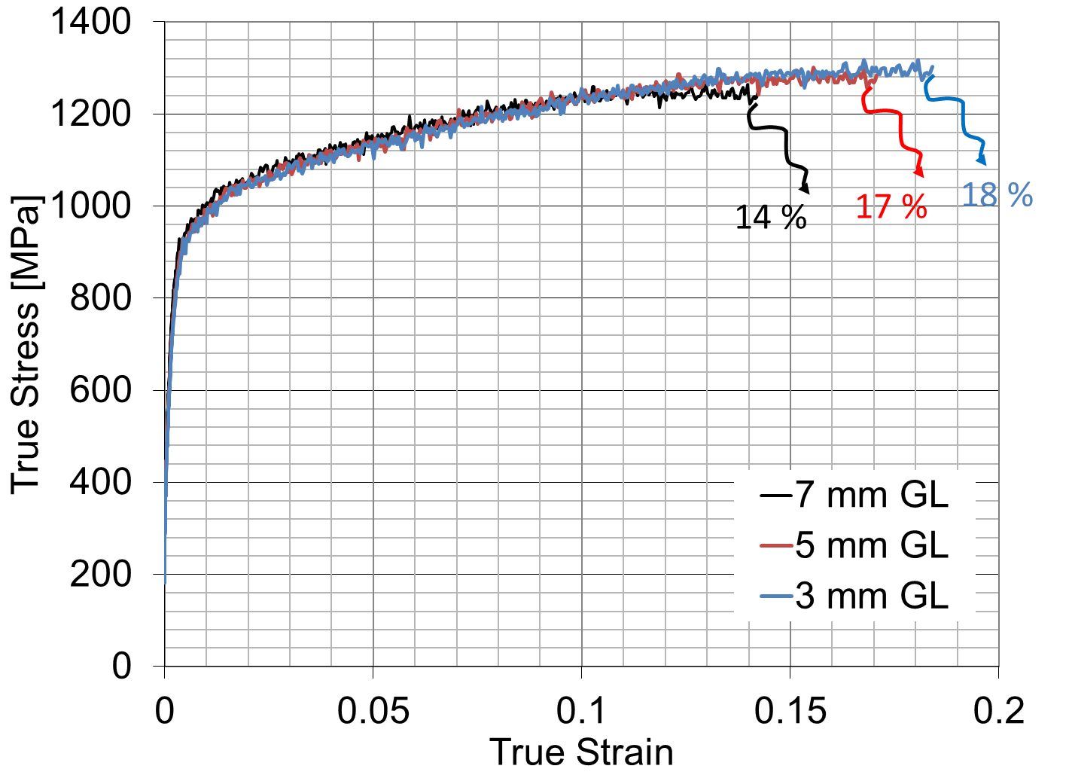
Localized Necking and Fracture
Localized strains mean ductility depends on the gage length chosen!
Opportunity for inverse analysis: remove ambiguity in ductility measurement
Analysis of the same test with three different gauge lengths (GL’s)
Notes:
How do you remove the ambiguity in ductility by identifying constitutive parameters?
Ambiguity in ductility is a consequence of the assumptions one makes about the state of stress and strain. In ASTM testing we have just yield, ultimate strength and total elongation to failure. It says nothing about the local strains in the region of the neck.

Slide 22
Localized Necking and Fracture
FEA Method
Virtual Fields Method (VFM)
Same as ringup, equilibrium deformation
Not possible due to the tri-axial stress state that develops in the localized necking region
Notes:
Note again the P = 0.75 corresponds well with the ISO recommendation of using the shoulders as part of the effective gauge length of the specimen as part of a correction of sorts.
But is the correction for the peaked strain profile, or is it due to yielding outside the gage section???

Slide 23
Conclusions
We consider opportunities for inverse analysis in dynamic tensile testing of sheet materials at NIST
Interested in getting more value out of experimental data
FEA-based vs. VFM/dVFM
FEA-based
Advantages – flexibility, easy dissemination of results
Disadvantages – computational cost, complexity
VFM/dVFM
Advantages: simplicity (elegance), speed, accuracy
Disadvantages: limitation to plane strain, for dVFM – balance camera speed with displacement noise
Better leveraged through different test method design
Notes:
Is it plane strain or plane stress? There can be no virtual work into the page, so either case zero stress or zero strain through the thickness is ok? Need to think about this.

Slide 24
Conclusions
New Data Dissemination Paradigm?
Rather than (or in addition to) disseminating values of constitutive parameters determined from test data, we provide only the raw data:
Geometry data
DIC & strain gage data
Other relevant boundary condition data
Experimentalists concentrate on data quality, modelers/users apply their favorite method to obtain the information they need from the data
Notes:
Particularly with the advent of simpler, more accessible methods to deduce material property values directly from DIC data sets, does it make sense to re-think the paradigm we have at NIST (and most other measurement institutes that offer mechanical property measurements) from the old way of determining the constants ourselves to a new way that lets users deduce the values themselves from the data?

Slide 25
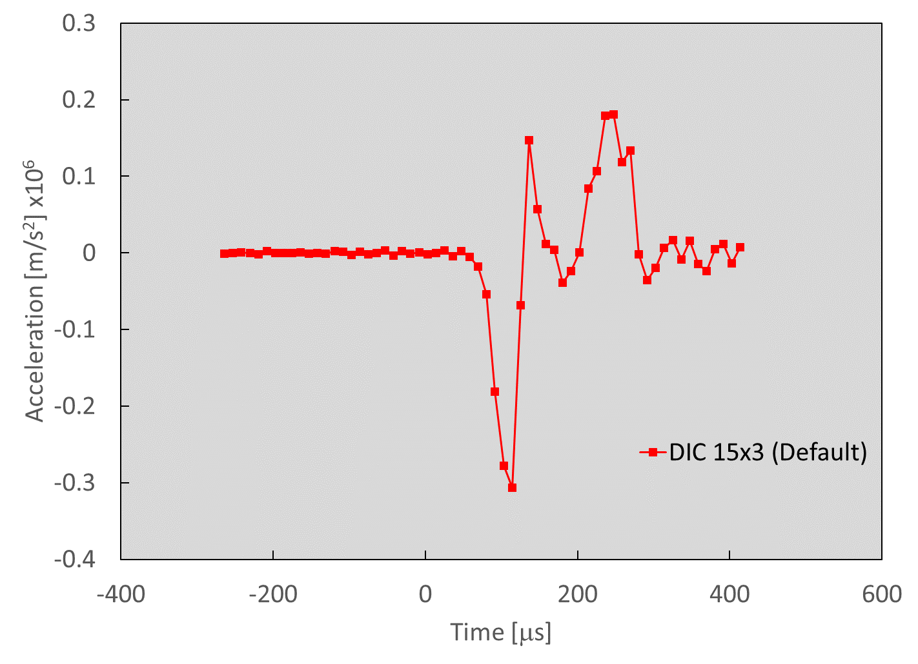
Acceleration Noise at 90 kfps
Displacement [mm]
Low noise prior to deformation
Higher noise post-deformation
Post-deformation noise is increased by real vibration in the sample. Vibrations during initial acceleration are also possible, may confound force estimation.

Slide 26
High Speed Digital Image Correlation
Stereo (3D) DIC Measurements
Dual cameras
90k to 180k frames/second
1 microsecond electronic shutter
2D DIC Measurements
Single camera
500k frames/second
Lighting: High intensity flash
125 W-s, 1.5 ms duration
Air Force Target image captured under experimental conditions
Notes:
18 pixels per mm is measured directly from the image. It corresponds pretty well with the 7 linepairs per mm obtained off the airforce target – one line pair is a black and white transition, which is at a very minimum 2 pixels wide. Due to distortions, we cannot see this perfectly, so there are fewer linepairs per mm than one would guess if one had 18 pixels per mm (9 linepairs).
16 microsecond exposure with the continuous light (1/62,500 s)

Slide 27
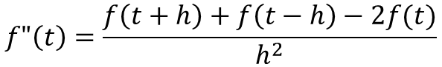
Accelerations from Central Differencing
Order h²
Order h⁴
$$f"\left(t\right)=\frac{f\left(t+h\right)+f\left(t−h\right)−2f(t)}{h^{2}}$$
3 time steps
$$f"\left(t\right)=\frac{−f\left(t+2h\right)+16f\left(t+h\right)−30f\left(t\right)+16f\left(t−h\right)−f\left(t−2h\right)}{12h^{2}}$$
5 time steps
Notes:
Note again the P = 0.75 corresponds well with the ISO recommendation of using the shoulders as part of the effective gauge length of the specimen as part of a correction of sorts.
But is the correction for the peaked strain profile, or is it due to yielding outside the gage section???

Slide 28
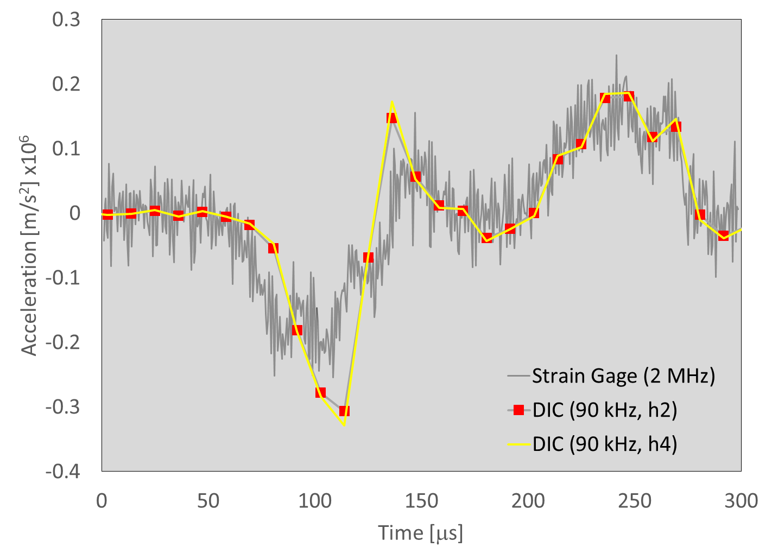
Ringup: 3D DIC on Sample (90k frames/s)
Effect of Order of Central Differencing
Displacement [mm]
DIC 15x3
Correlated
Region
Increasing the order of the derivative approximation (h² to h⁴) also has little effect

Slide 29
New Structural Materials for Automotive Lightweighting
Corporate Average Fuel Economy (CAFE) targets motivate vehicle weight reduction by introducing new, high strength structural materials
Advanced high strength steels (AHSS), aluminum & magnesium alloys, fiber-reinforced polymers
Crashworthiness of lighter vehicles is an issue
Vehicle engineering & material performance
High strain rate behavior of new materials must be measured

Slide 30
Metrology – Origins of Peaked Strain Profile
End effects (Specimen Geometry)
Competition between achieving a high strain rate and uniform strain
ASTM E-8 Tensile Specimen: Minimum GL/GW = 6
ISO High Rate Specimen: Min GL/GW = 2 (Used here)
Strain hardening rate (Material Effect)
Strain uniformity affected by material’s strain hardening rate
Thermal softening (Material Effect)
Particular to dynamic testing

Slide 31
Finite Element Model of Kolsky Bar Test
Quarter Symmetry Model
Johnson-Cook Material Model
Power law hardening
Rate sensitivity
Thermal sensitivity
Literature parameters for:
4340 Steel (AHSS analog)
OFHC Copper
Inelastic heat fraction: 0.9
Adiabatic vs. Isothermal Analyses Compared
ISO Geometry (10 mm Gauge Length)
3798 Brick Elements

Slide 32
Johnson-Cook Viscoplastic Model
Yield & Strain
Hardening
Rate Hardening
Thermal Softening
Hardening
Parameters
Material Parameters¹
Material | A | B | n | c | m
OFHC Copper | 90 MPa | 292 MPa | 0.31 | 0.025 | 1.09
4340 Steel | 792 MPa | 510 MPa | 0.26 | 0.014 | 1.03
¹M.A. Meyers, Dynamic Behavior of Materials, Wiley, 1994

Slide 33
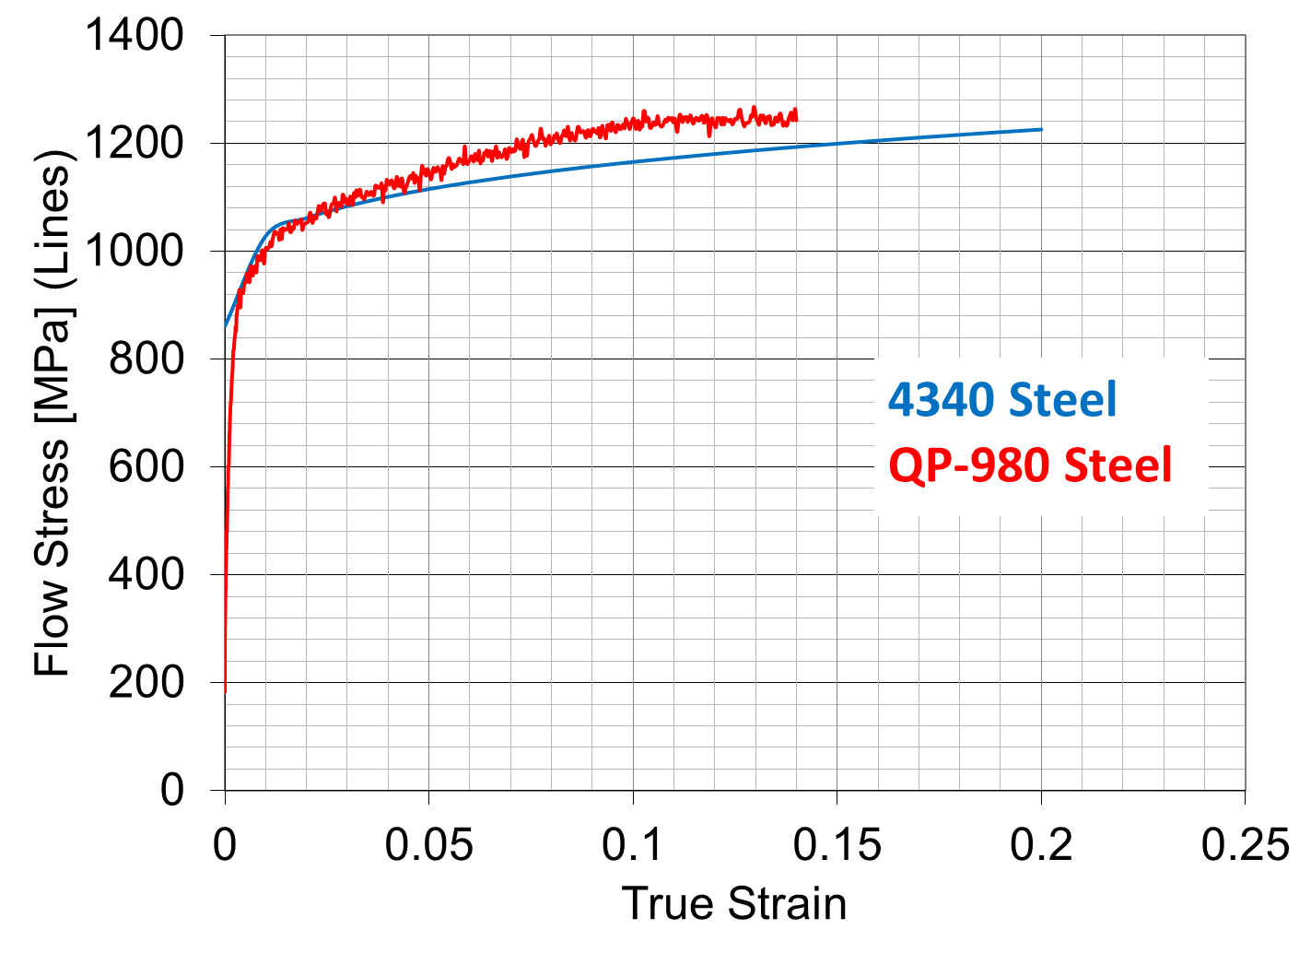
4340 vs. QP 980

Slide 34
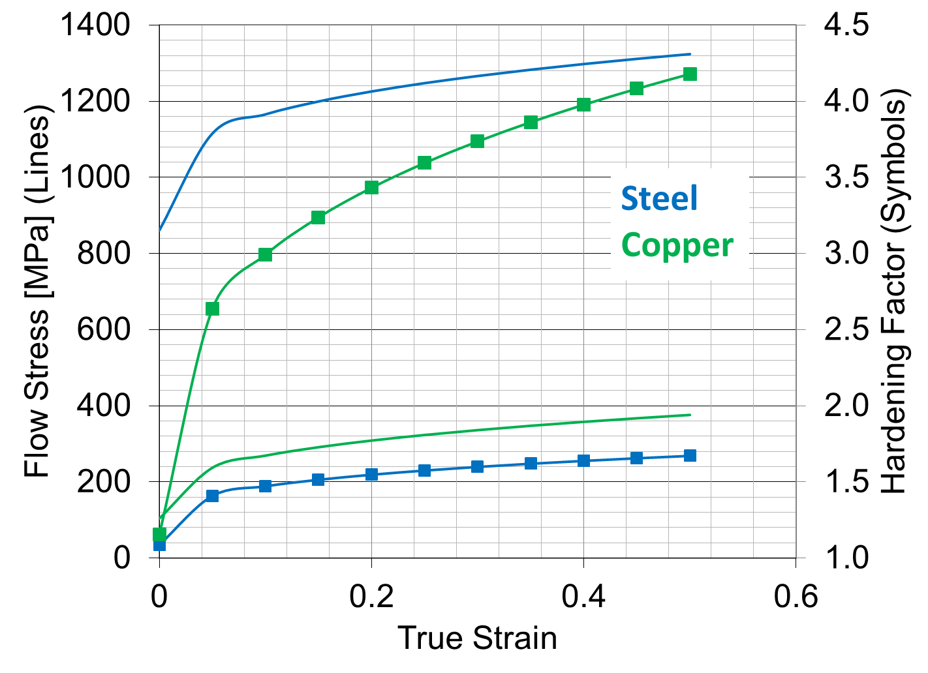
Copper vs. 4340 Steel: Hardening Rate
Copper hardens to over 4 times its initial yield strength (A), compared to 1.6 for 4340 steel

Slide 35
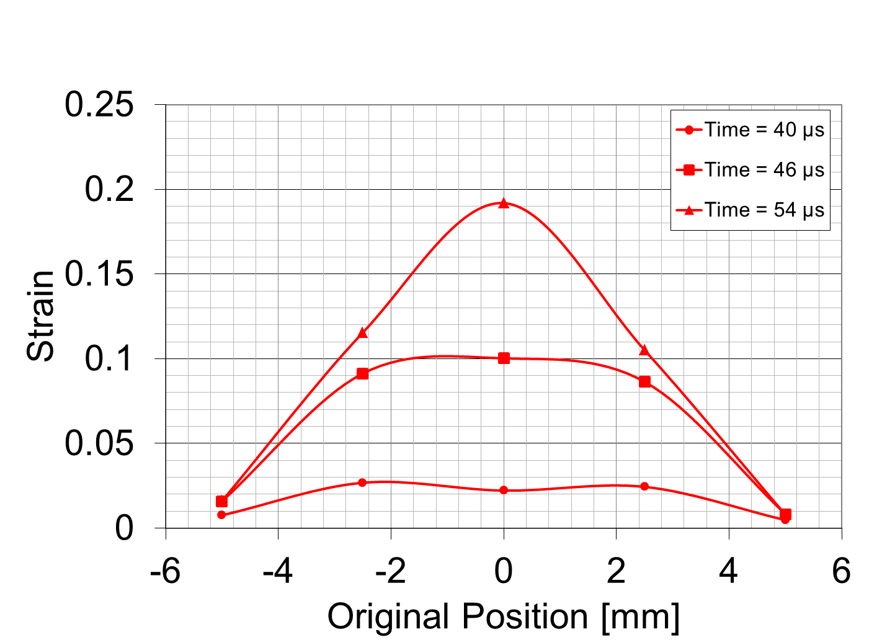
Simulation: 4340 Steel with Adiabatic Heating

Slide 36
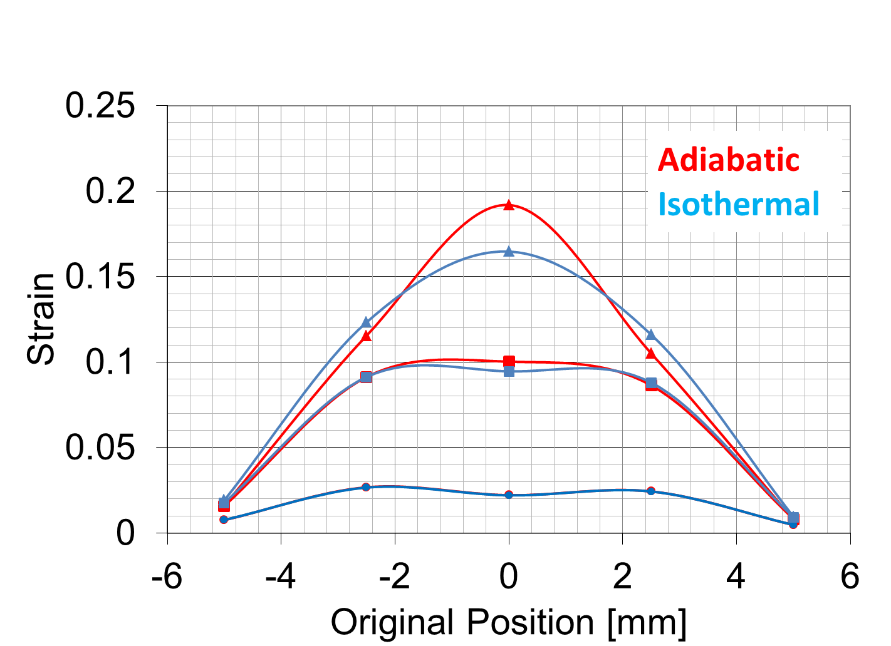
Simulation: 4340 Steel, Adiabatic vs. Isothermal

Slide 37
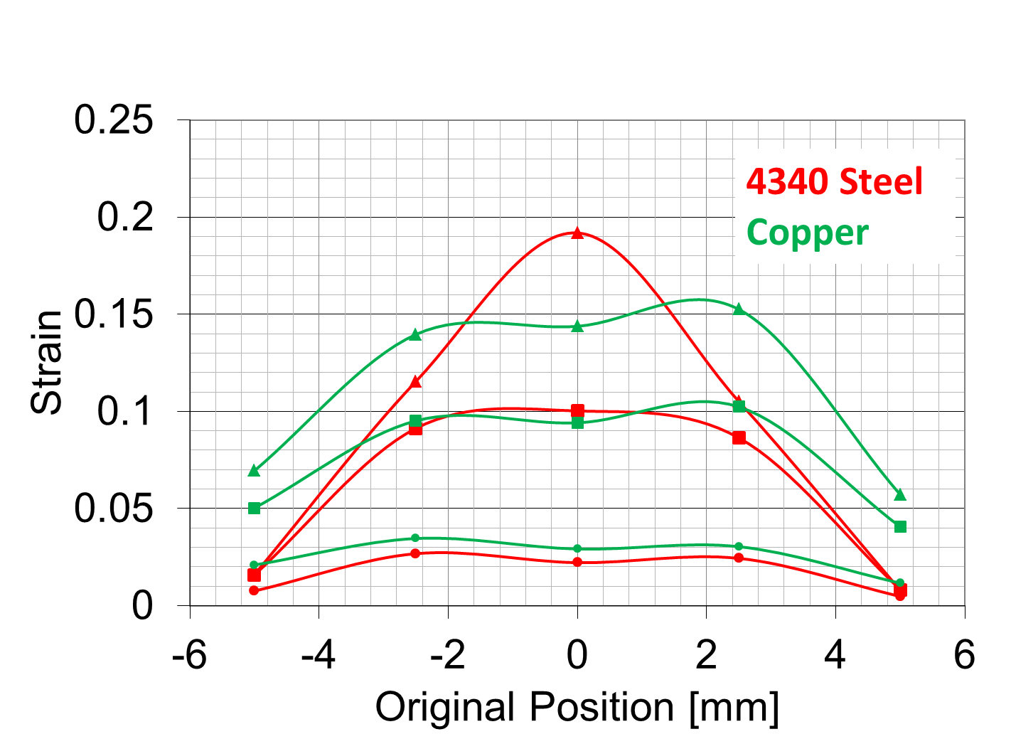
Simulation: Copper (Adiabatic) vs. 4340 Steel (Adiabatic)

Slide 38
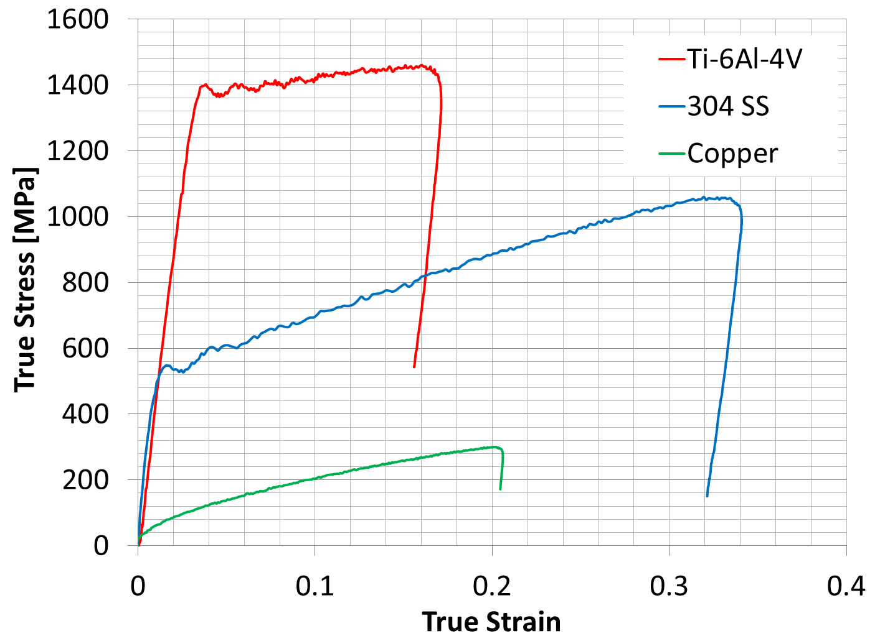
Experiments: Strain Uniformity in Copper, 304 SS and Ti-6-4
Compression Kolsky Bar Data – for dynamic strain hardening
Hardening rates vary dramatically even during dynamic loading

Slide 39
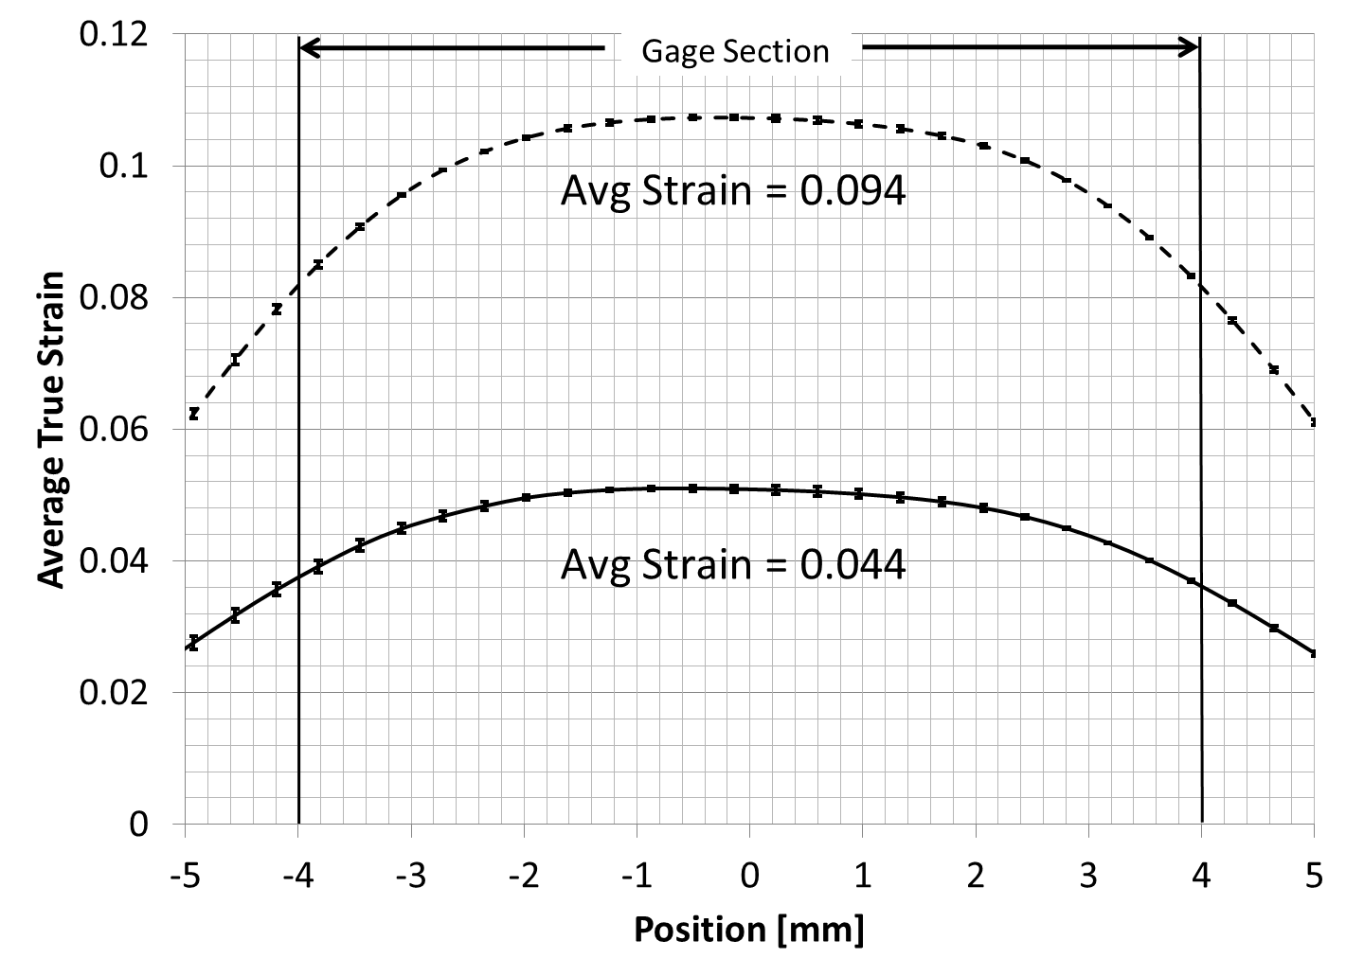
DIC Measurements: 304 Stainless Steel
304SS Specimen Dimensions [mm]

Slide 40
“Banana Curve” For Advanced Automotive Materials
Strength vs. Ductility – Map to define material performance target BASED ON SINGLE PIECE OF DATA (static or dynamic stress-strain curve) !

Slide 41
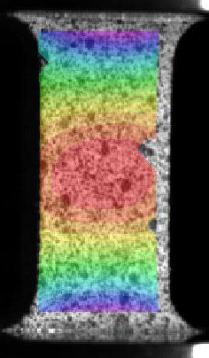
Digital Image Correlation
7 mm gauge length
DIC Grid Not to Scale
DIC Analysis (varies here)
21 pixel subsets & 7 pixel offset
One measurement point every 0.4 mm
Area Average
Averages strains over nominal gage area
Axial Strain Distribution
Averages axial strains over cross sections
Notes:
Thermal transformations can occur between 1 second and 1 minute that can completely change the flow stress of many materials.
Grid is a bit bigger than reality and intentionally not overlapped for ease of interpretation

Slide 42
High Speed Digital Image Correlation
Stereo DIC
62,500 frames/second
129 x 336 pixels
~18 pixels/mm
7 line pairs/mm (Air Force Target)
High intensity flash
125 W-s, 1.5 ms duration
Triggered off striker bar velocity sensor
Allows 1 microsecond electronic shutter to eliminate motion blur
Air Force Target image captured under experimental conditions
Notes:
18 pixels per mm is measured directly from the image. It corresponds pretty well with the 7 linepairs per mm obtained off the airforce target – one line pair is a black and white transition, which is at a very minimum 2 pixels wide. Due to distortions, we cannot see this perfectly, so there are fewer linepairs per mm than one would guess if one had 18 pixels per mm (9 linepairs).
16 microsecond exposure with the continuous light (1/62,500 s)

Slide 43
NIST Tension Kolsky Bar Analysis
Incident, transmission bars not impedance matched
Modified strain rate equation:
E_{i}A_{i}
L
E_{t}A_{t}
Incident Bar
(Steel, 26 mm)
Transmission Bar
(Aluminum, 20 mm)

